Slide 1




1

Slide 2







team members
abdulmalik mahmoud
mohamed hany
yousab magid
2
manar ibrahim
hadeer abd elsattar
nada khaled

Slide 3
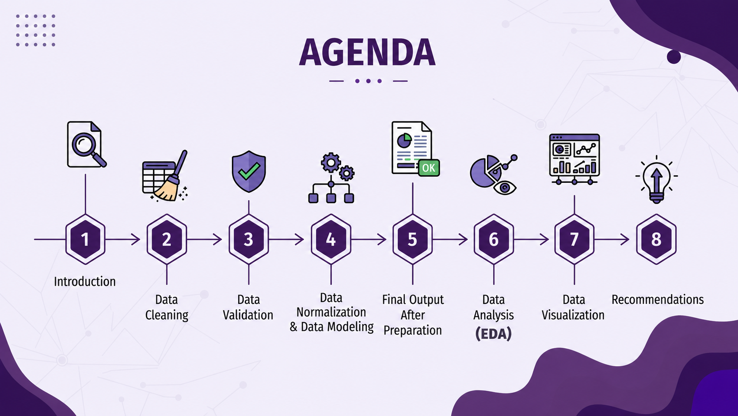
3
data prepreparation &preprocessing

Slide 4


introduction
Supply Chain Illustrator is an interactive web application designed to simplify supply chain concepts through clear visualizations and practical examples. It helps users understand the flow of products, inventory, suppliers, and logistics in an intuitive way. The platform provides an engaging learning experience by combining visual illustrations with real-world supply chain scenarios.
click here
4

Slide 5
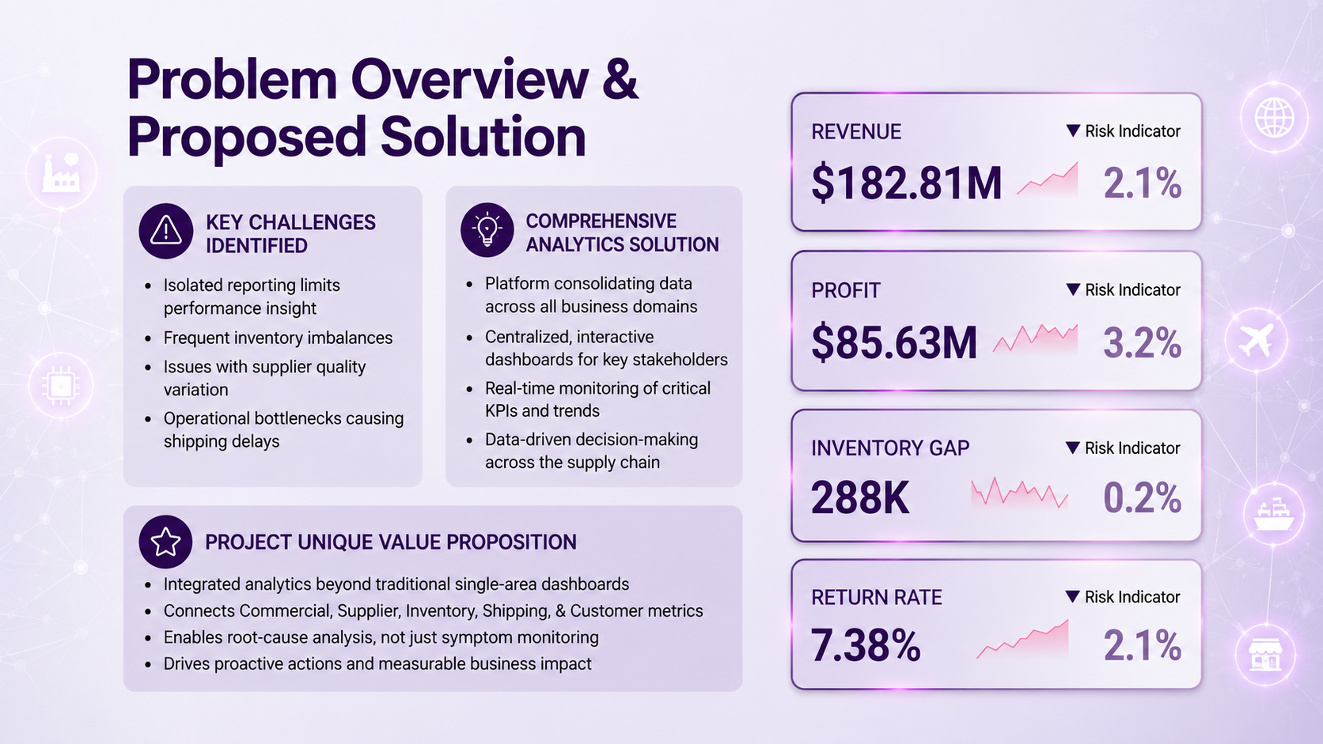
5

Slide 6
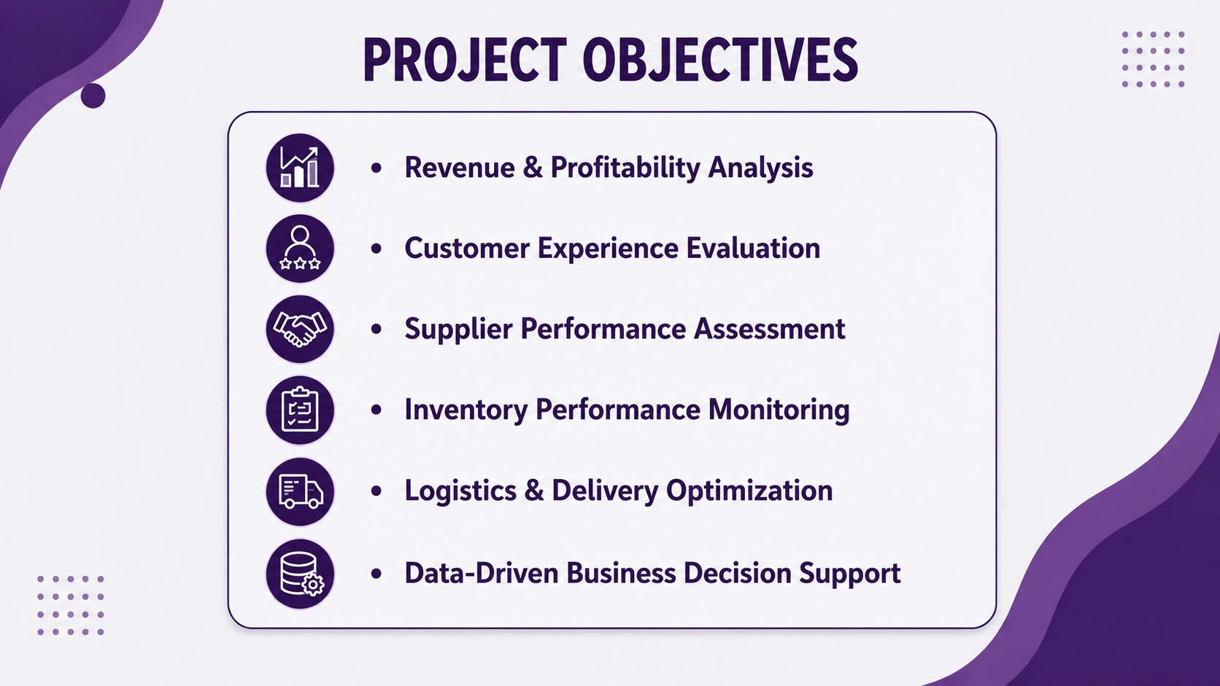
6

Slide 7
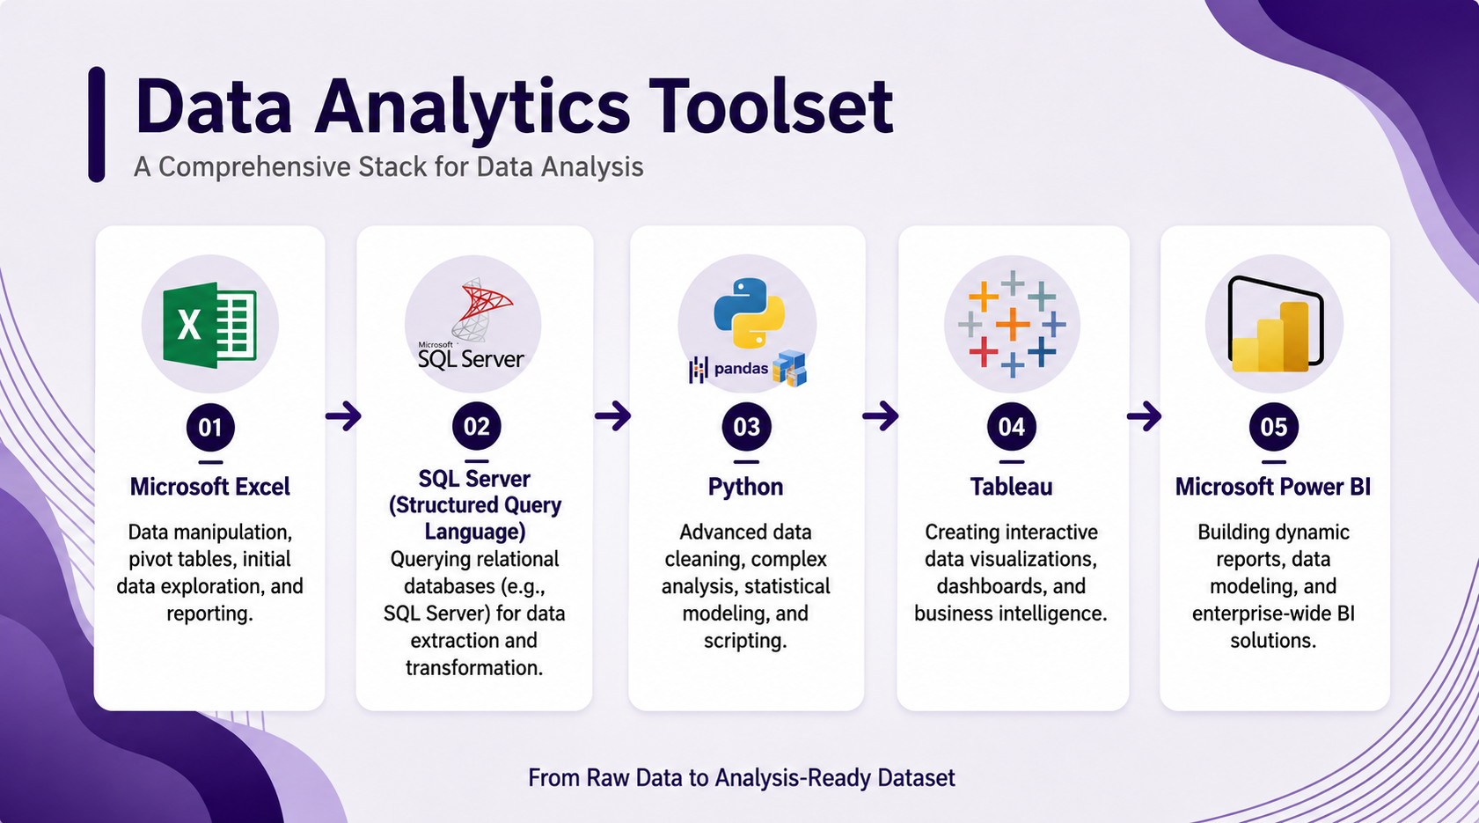
7

Slide 8
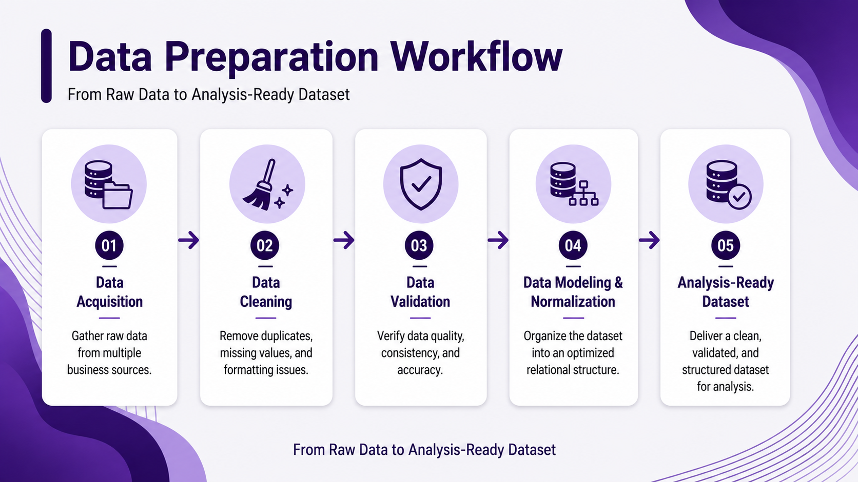
8

Slide 9
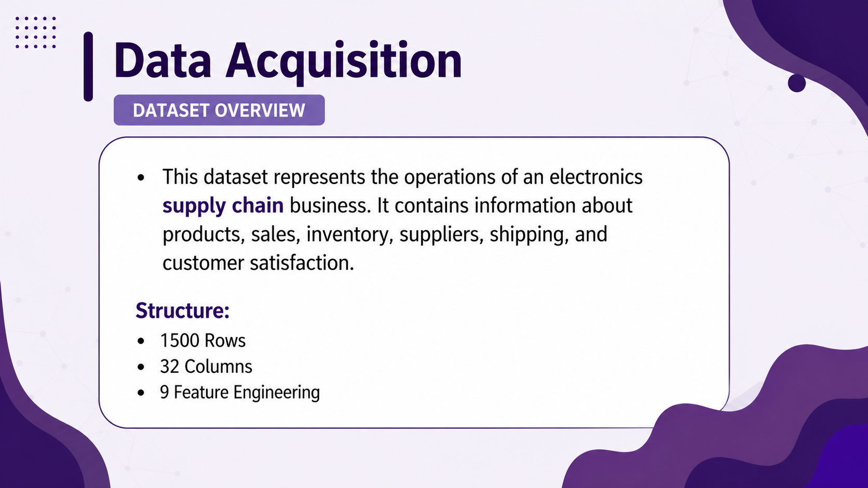
(calculated columns)
9

Slide 10
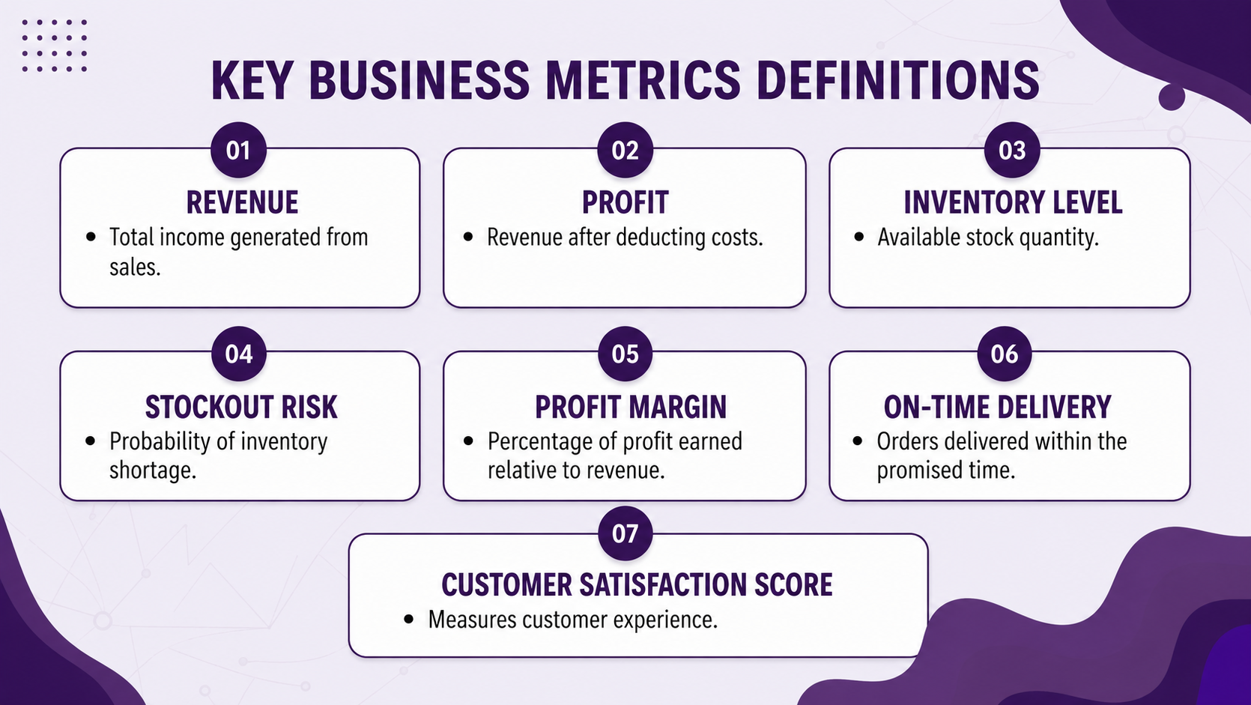
(calculated column)
10

Slide 11
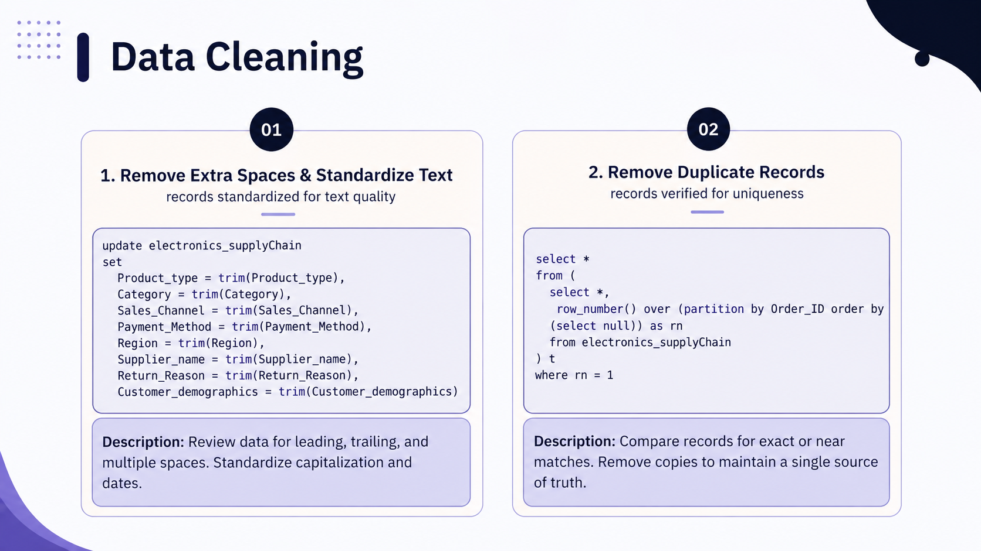
11

Slide 12
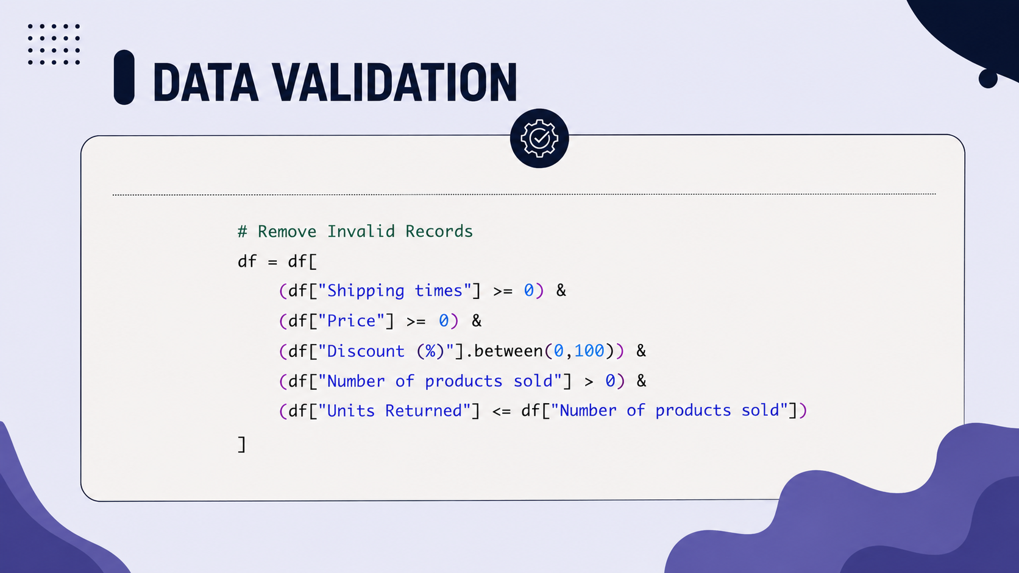
12

Slide 13
normalization &data modeling
13

Slide 14
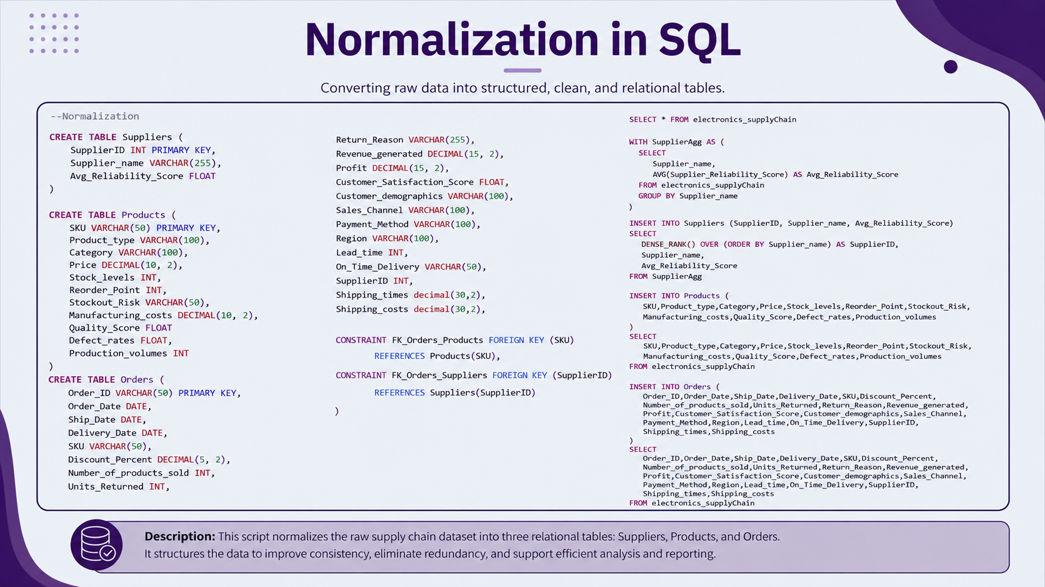
14

Slide 15
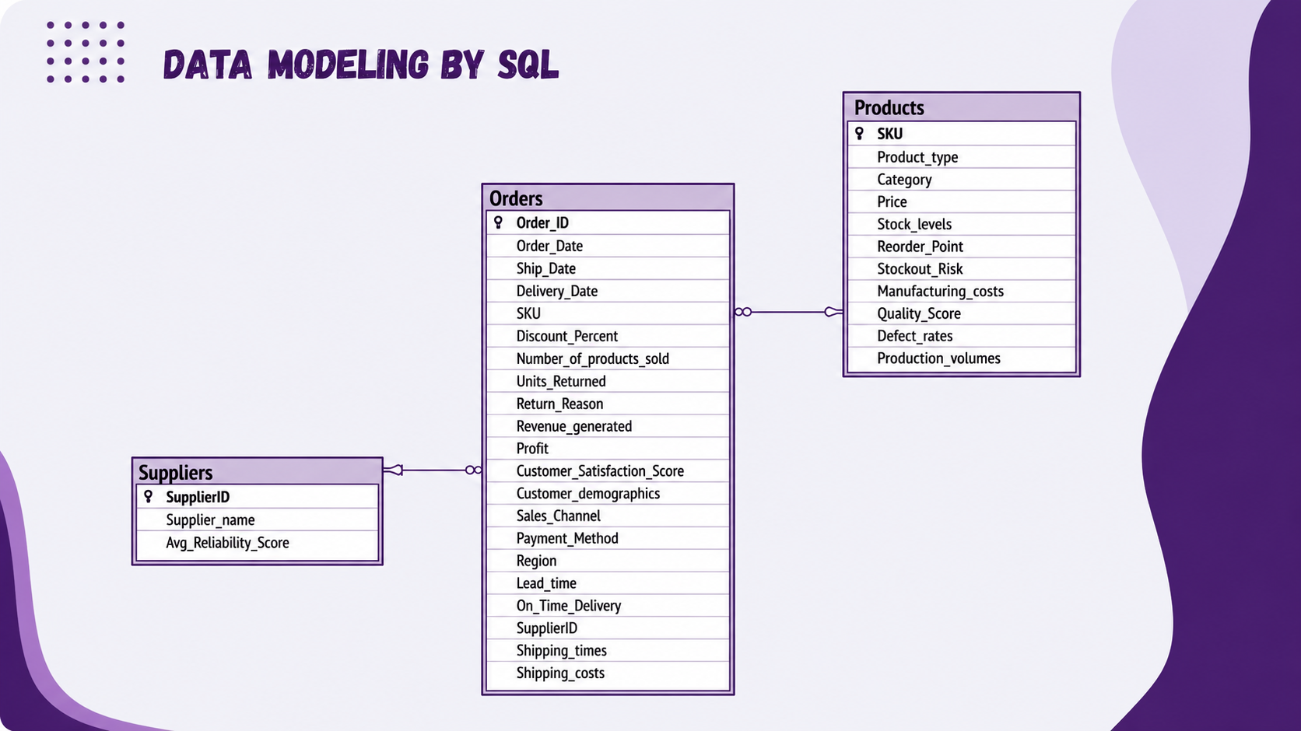
15

Slide 16
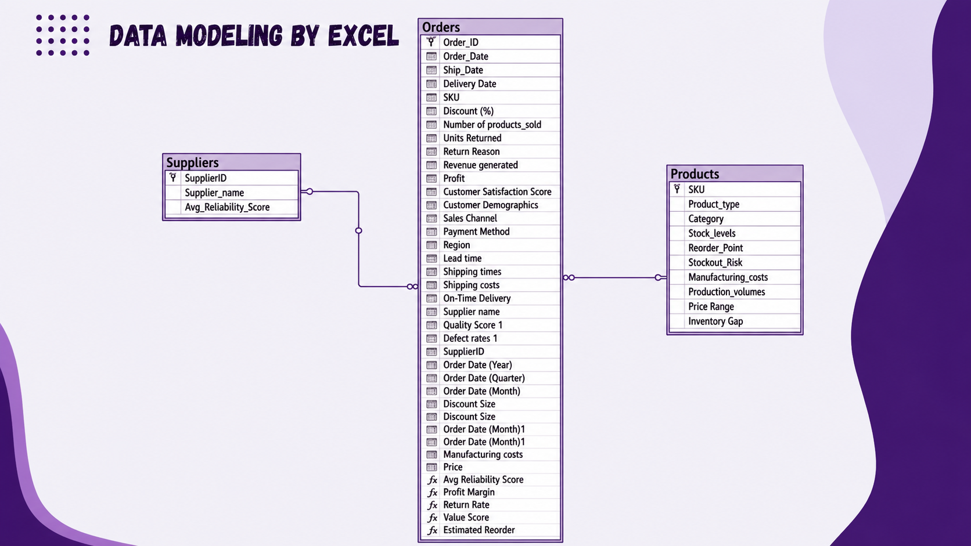
16

Slide 17
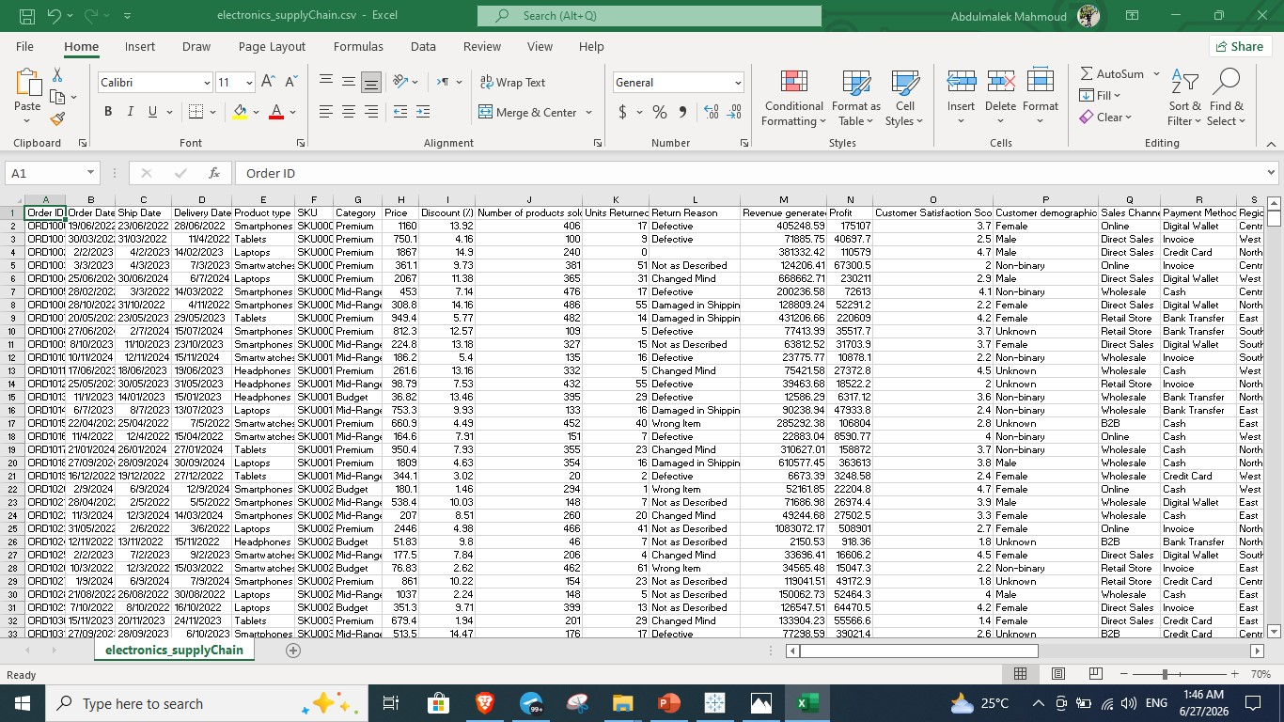
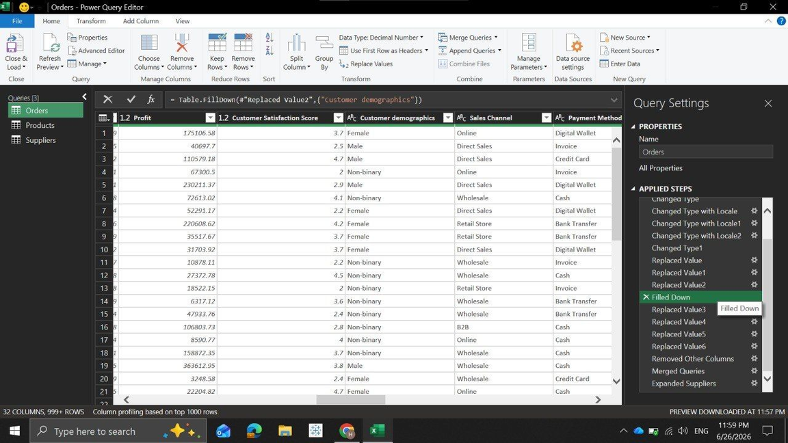
Analysis-Ready Dataset
Before
After
17

Slide 18
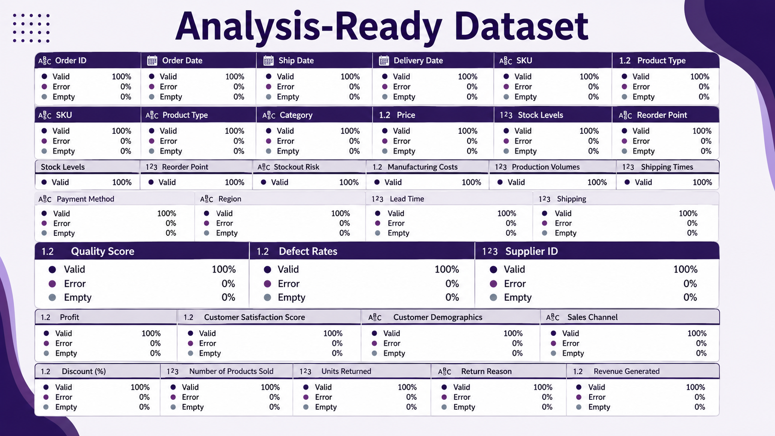
18

Slide 19
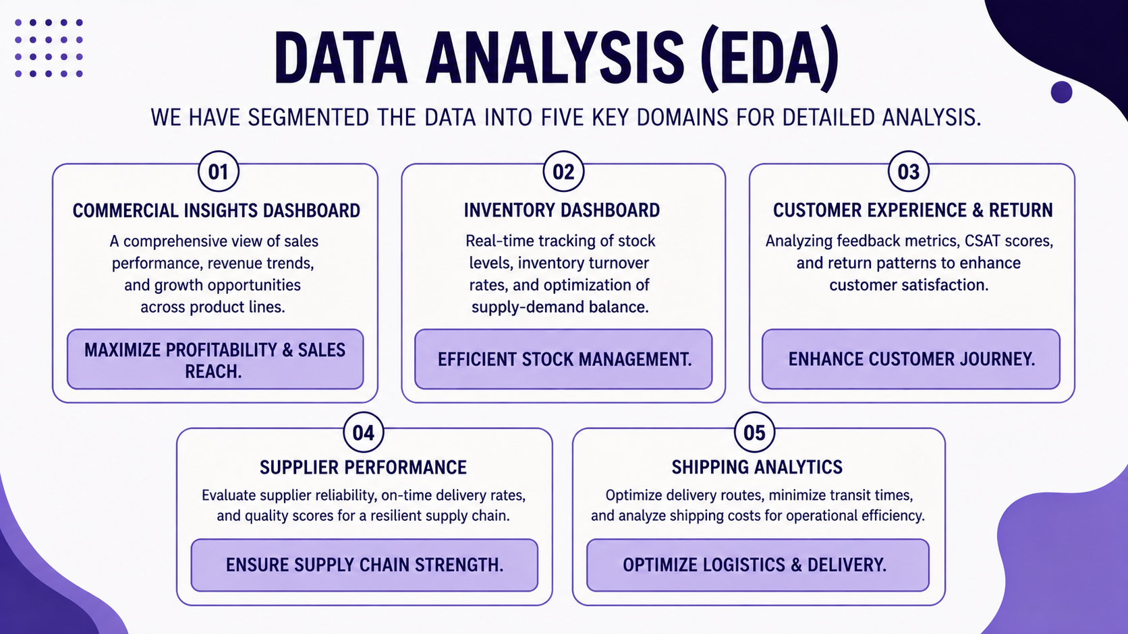
19

Slide 20
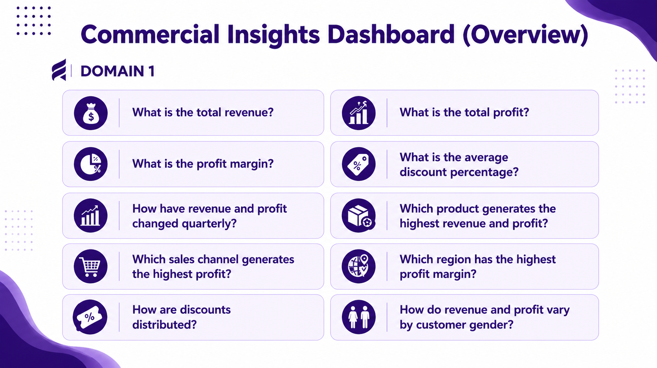
20

Slide 21
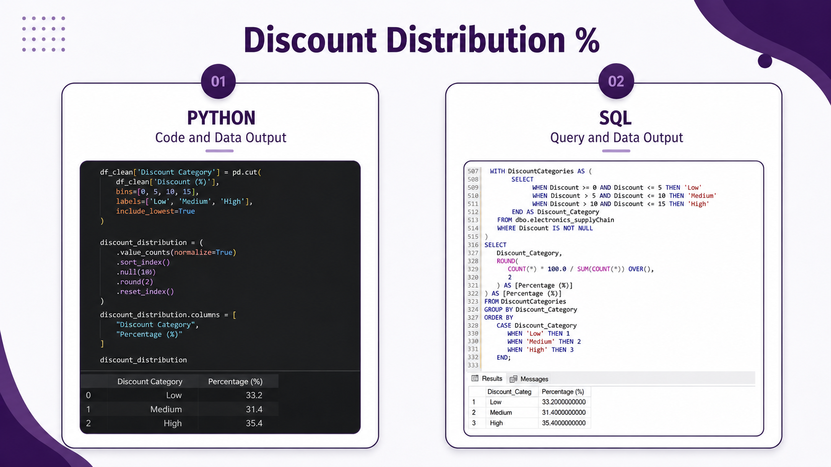
21

Slide 22
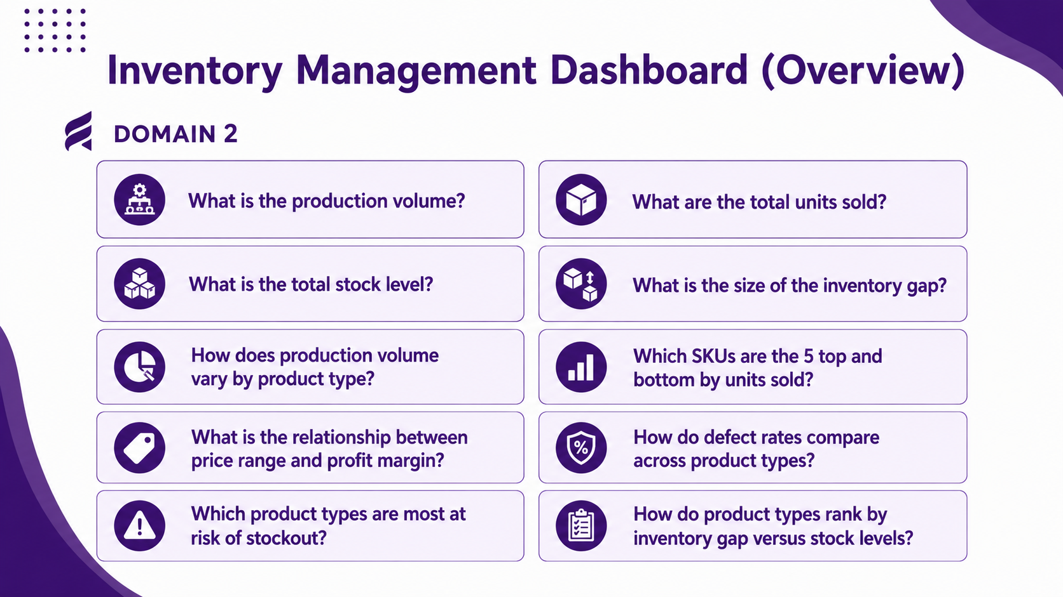
22

Slide 23
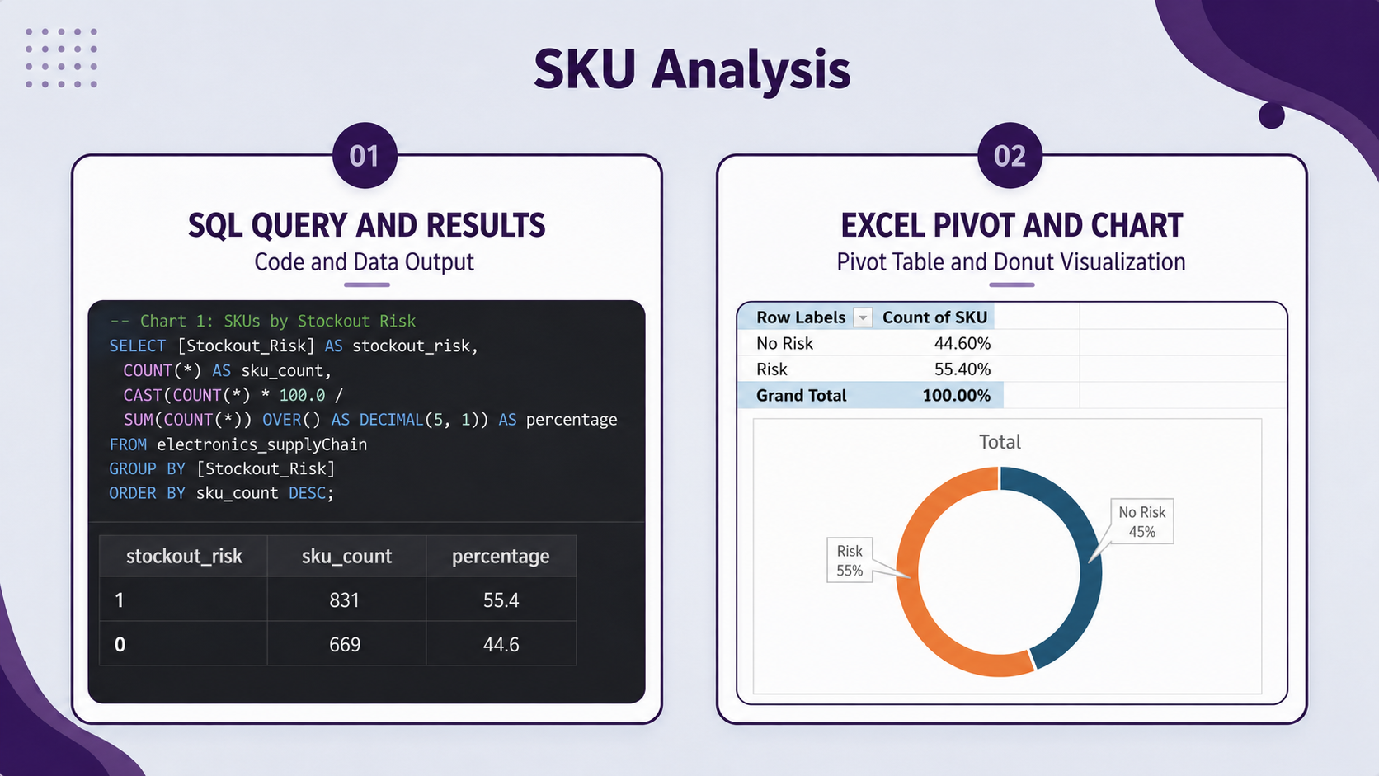
23

Slide 24
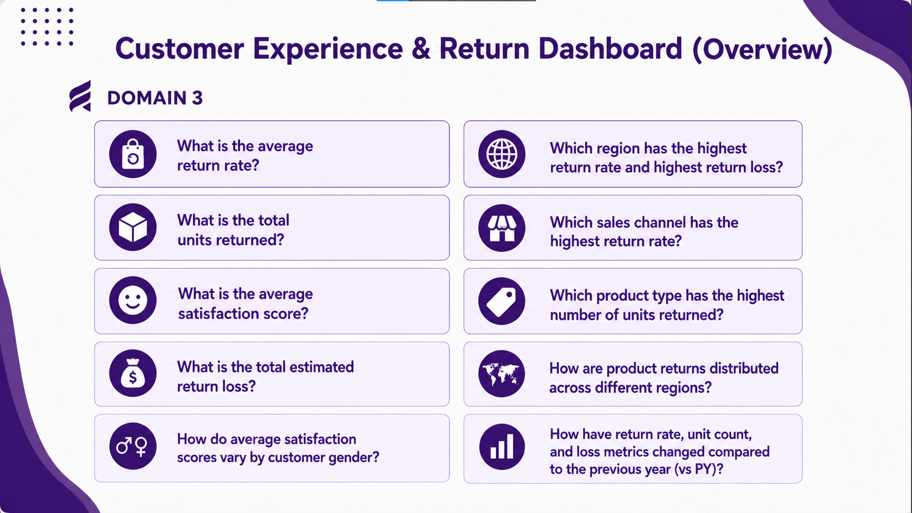
24

Slide 25
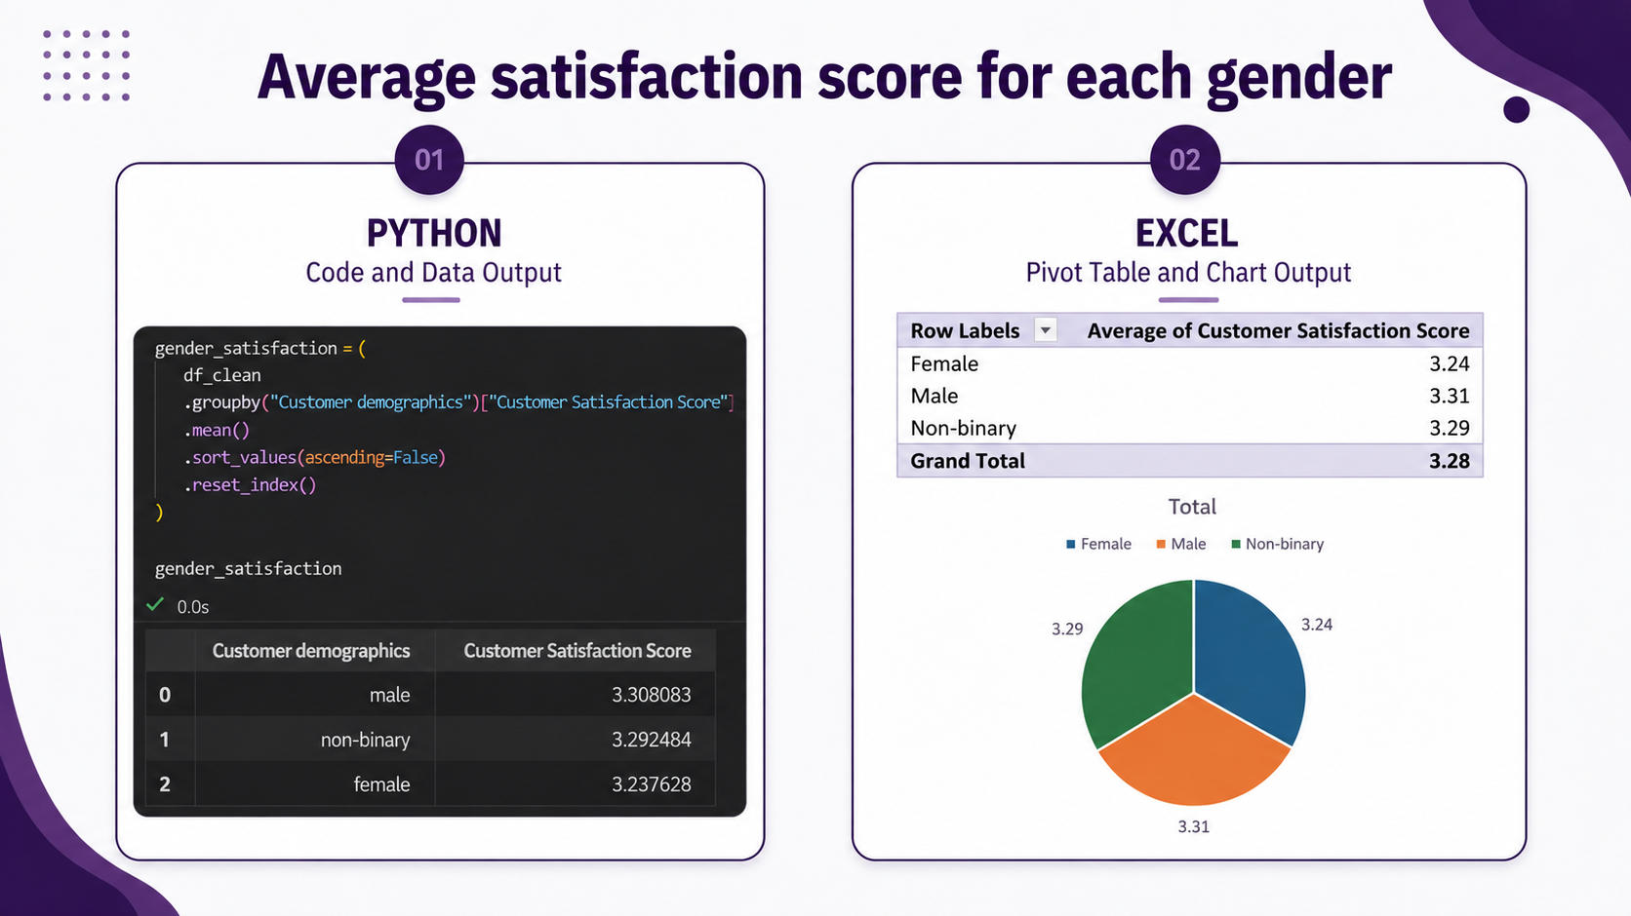
25

Slide 26
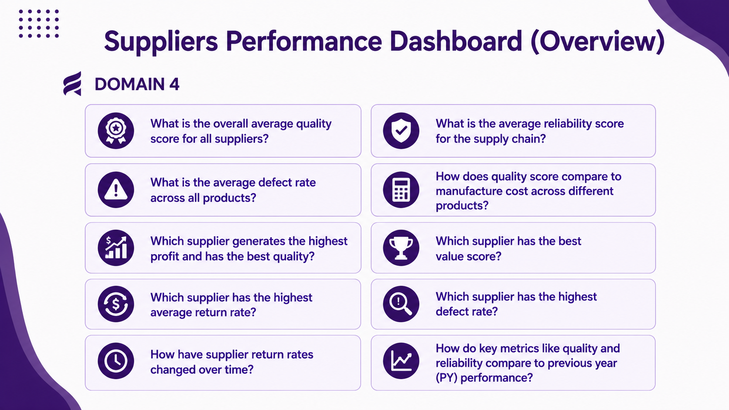
26

Slide 27
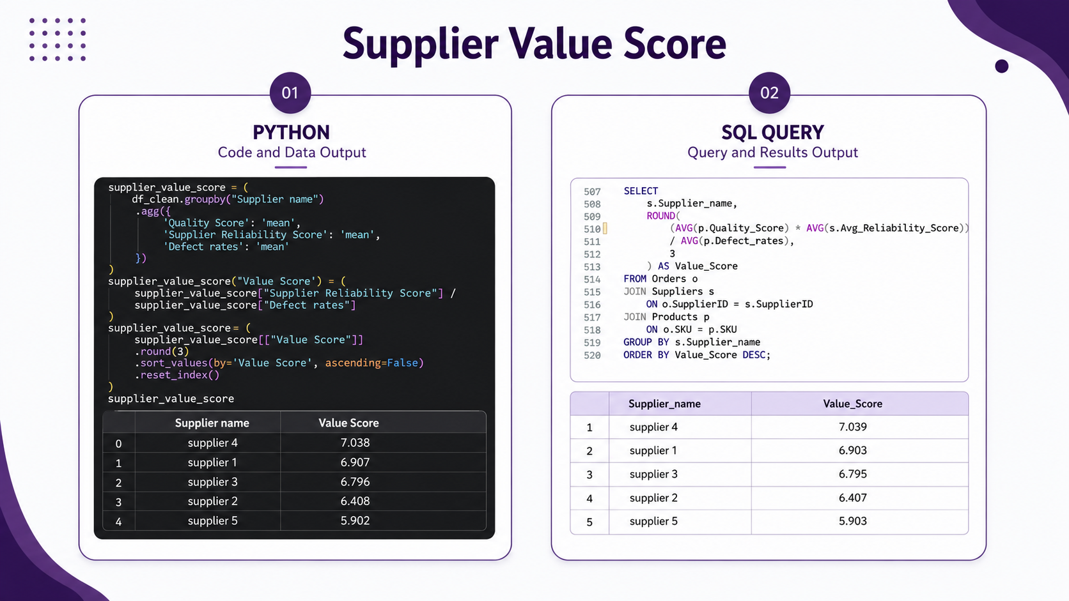
27

Slide 28
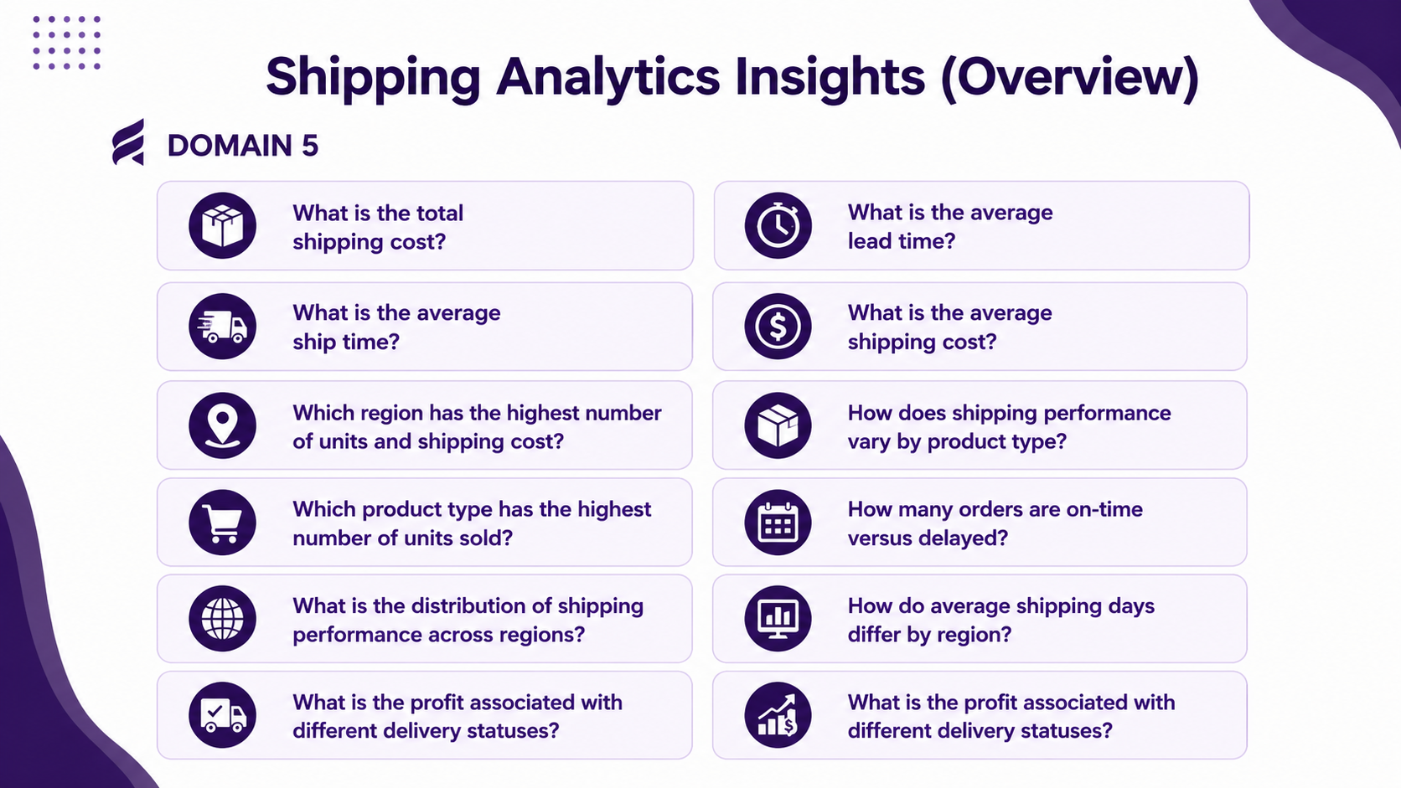
28

Slide 29
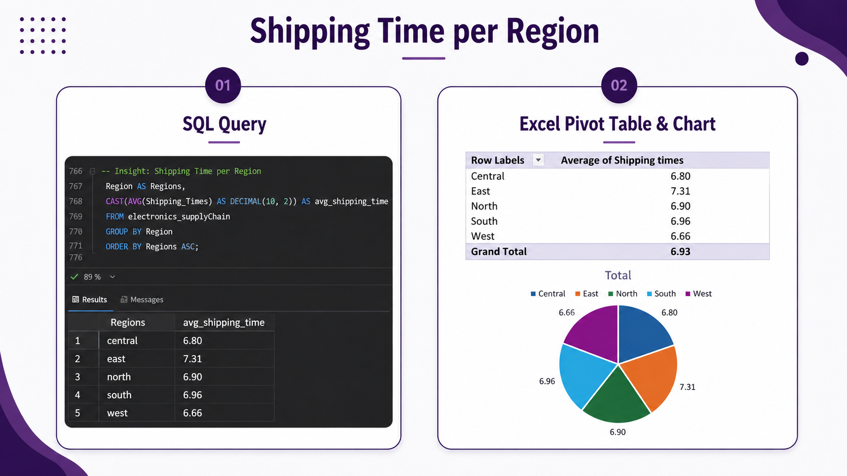
29

Slide 30
visualization
30

Slide 31
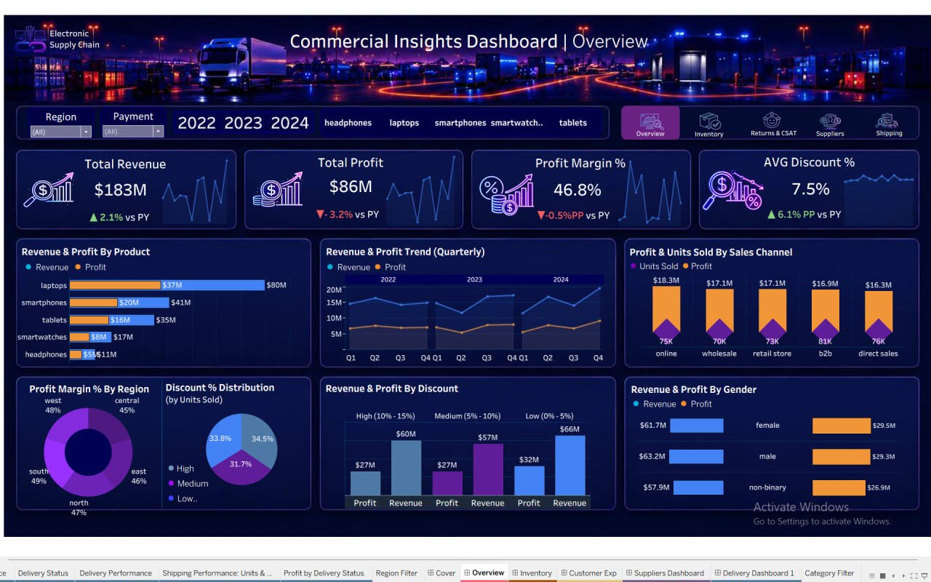

Slide 32
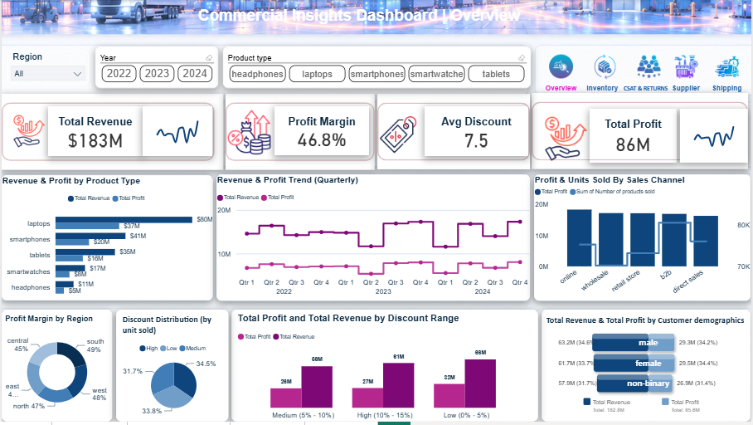

Slide 33
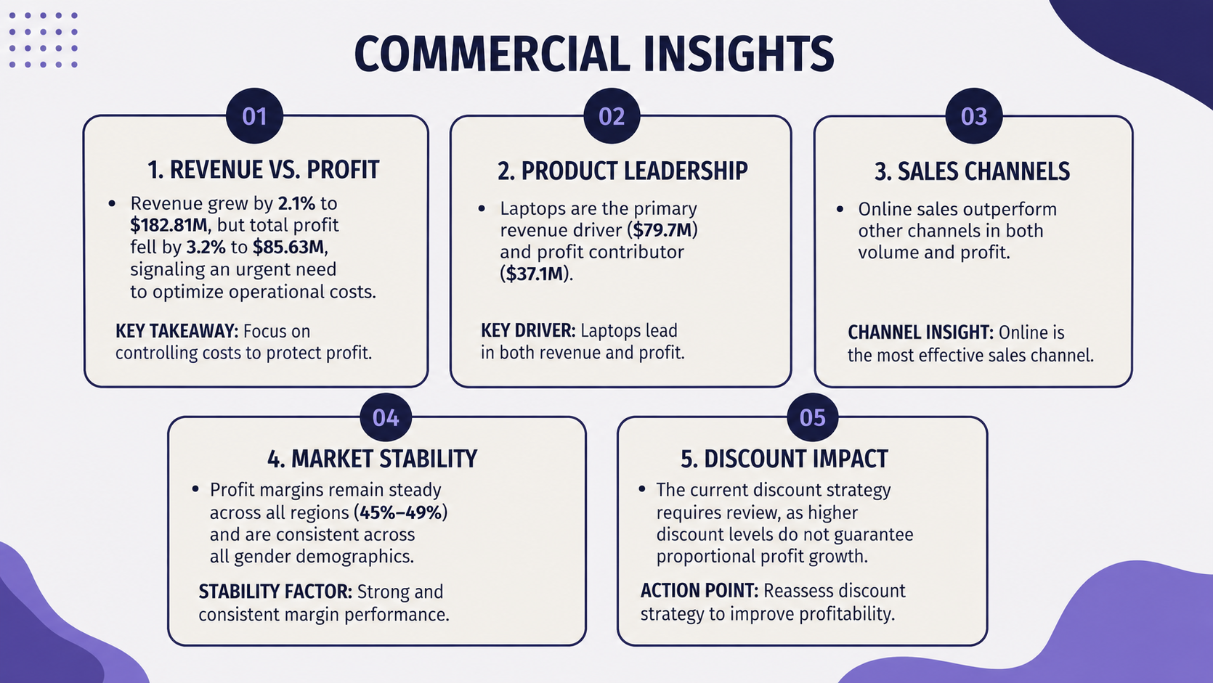
33

Slide 34
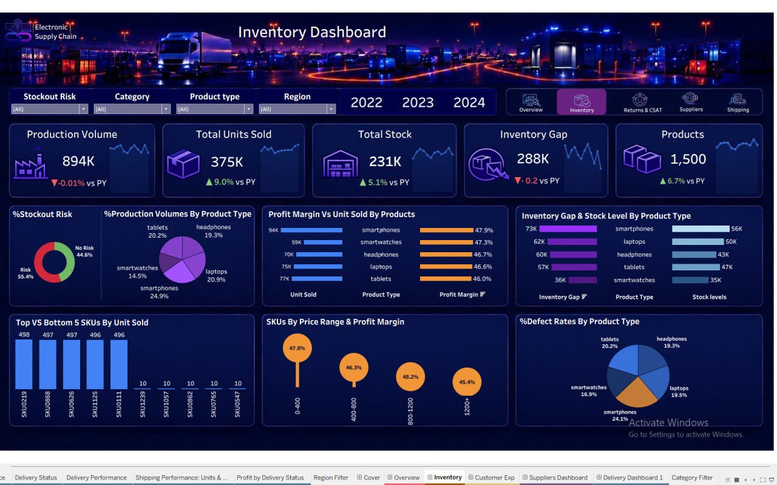

Slide 35
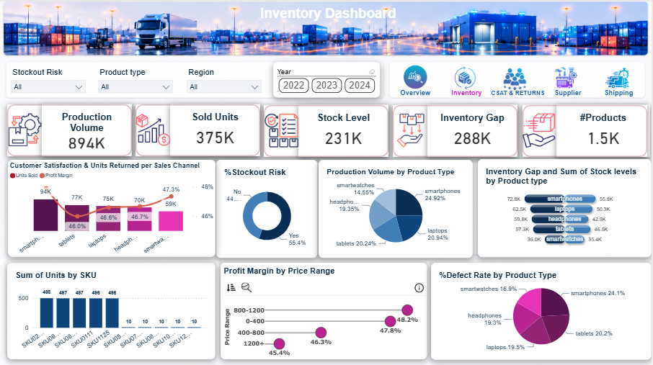

Slide 36
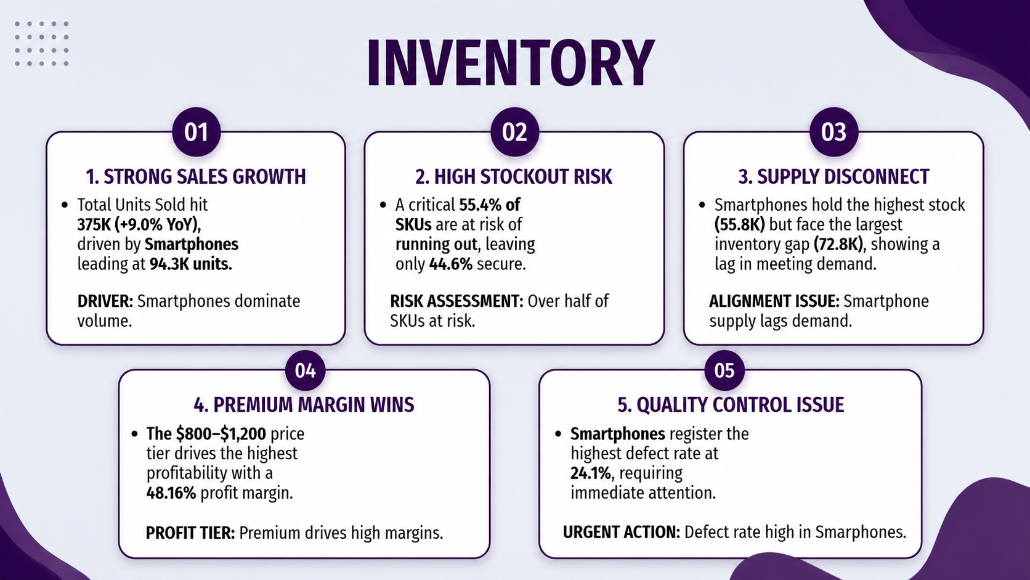
36

Slide 37
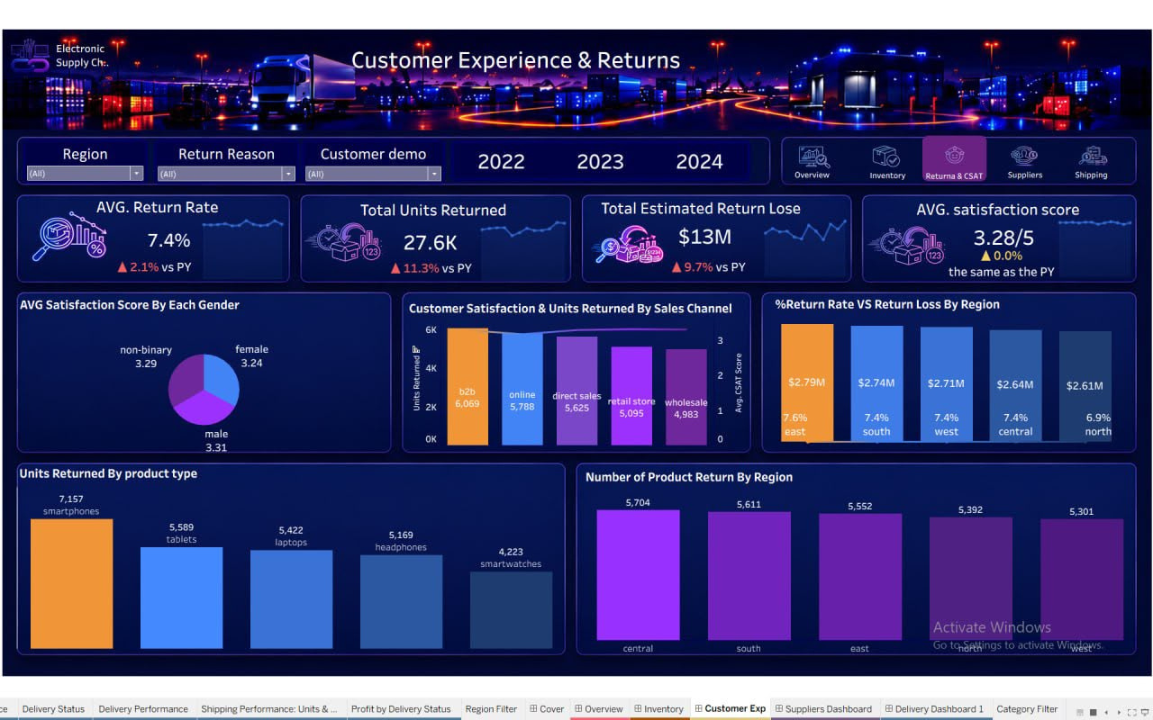

Slide 38
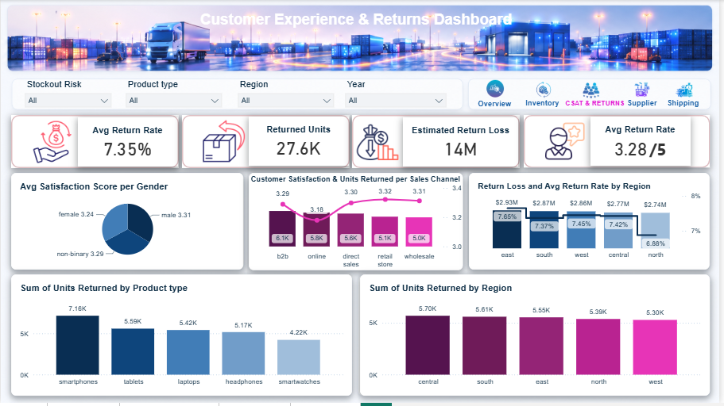

Slide 39
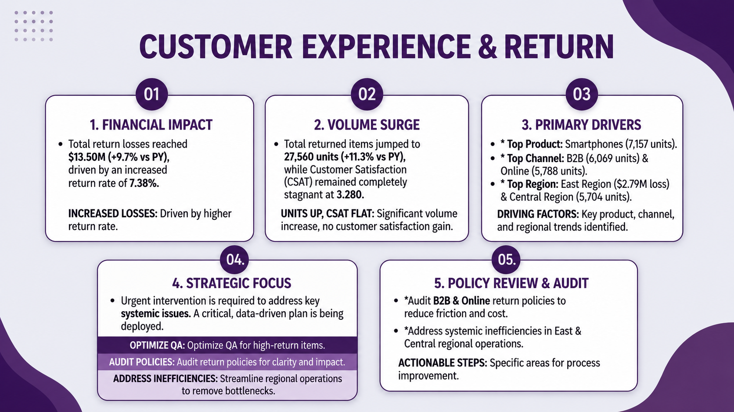
29

Slide 40
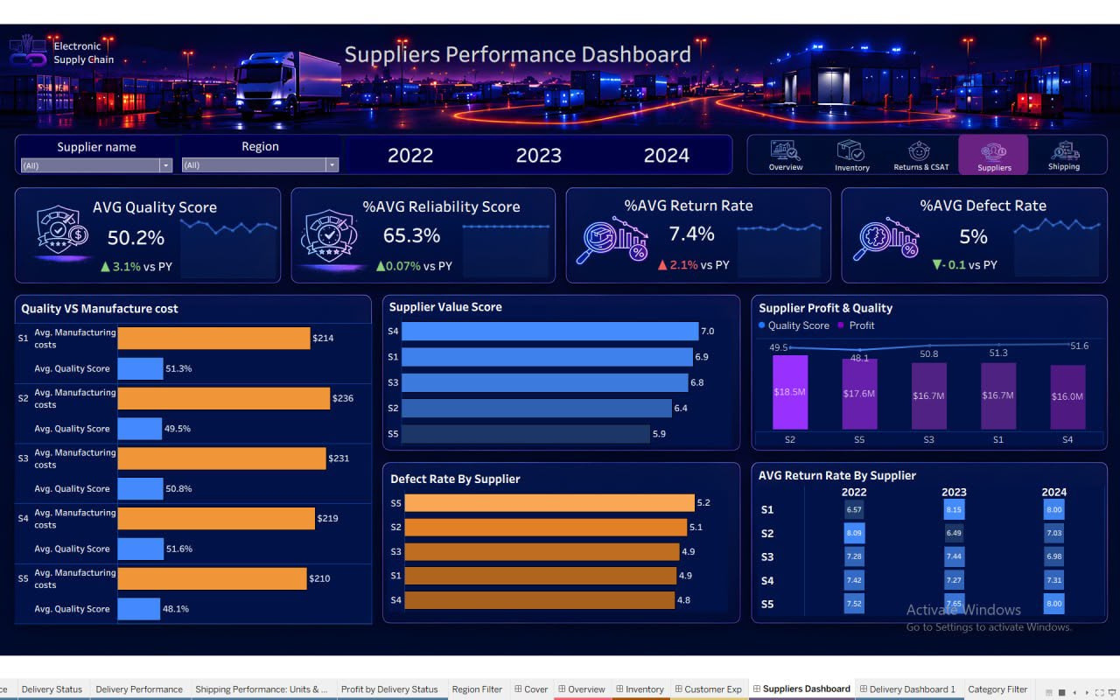

Slide 41
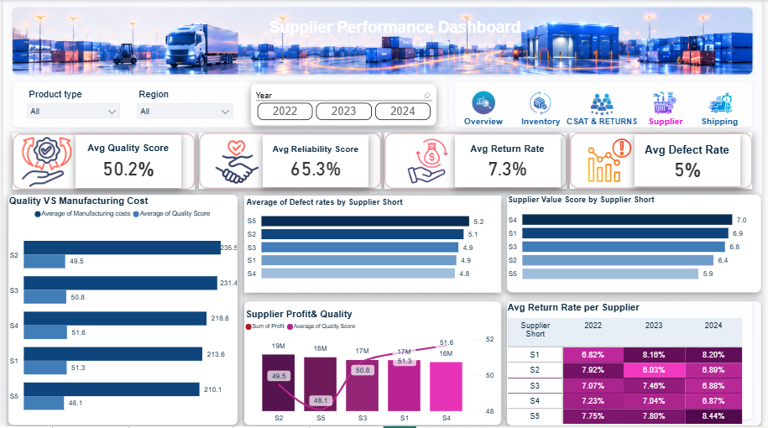

Slide 42
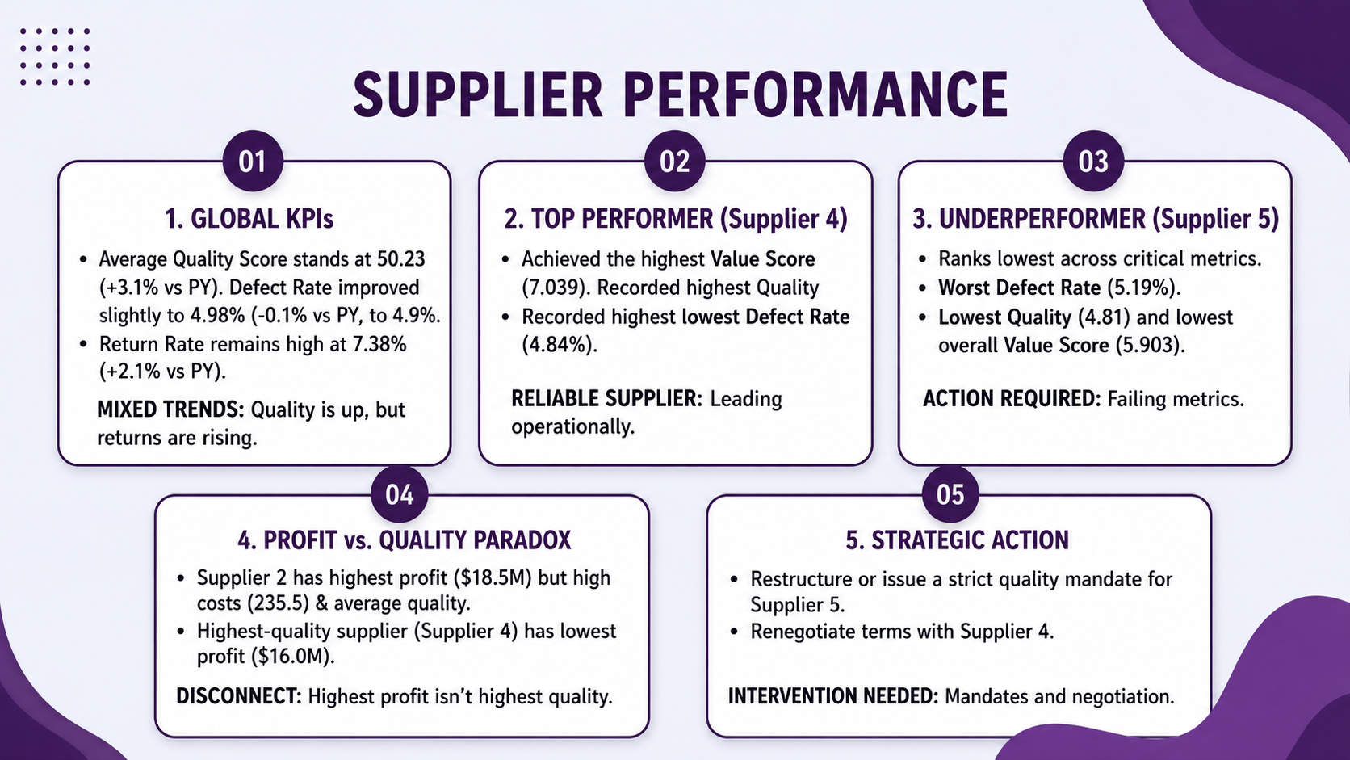
42

Slide 43
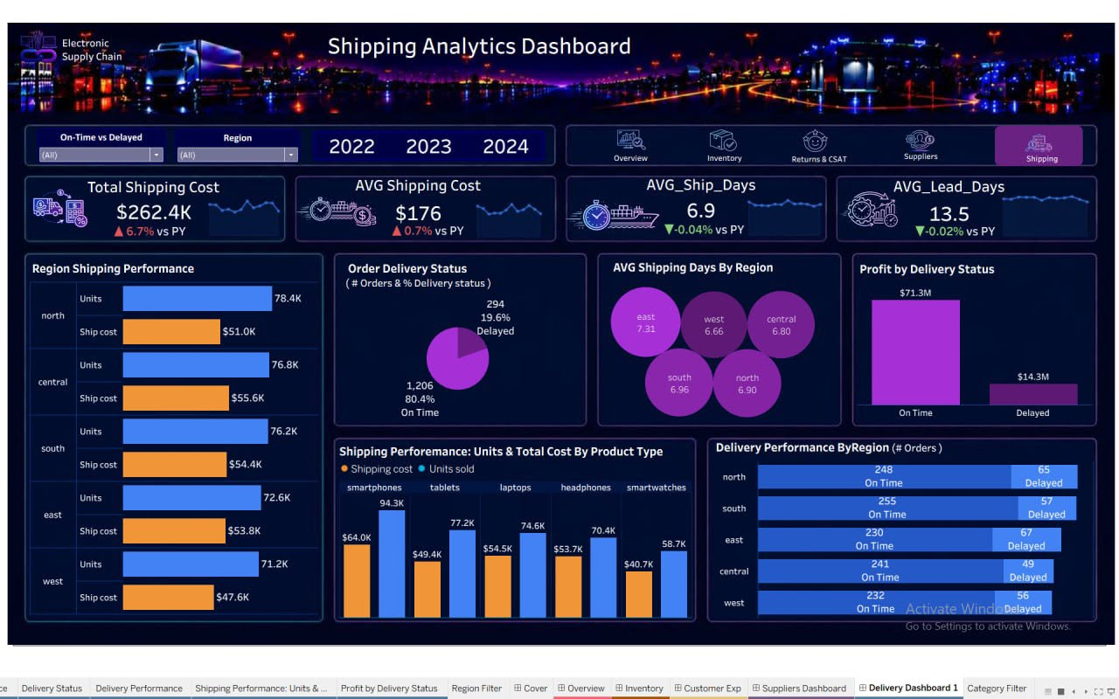

Slide 44
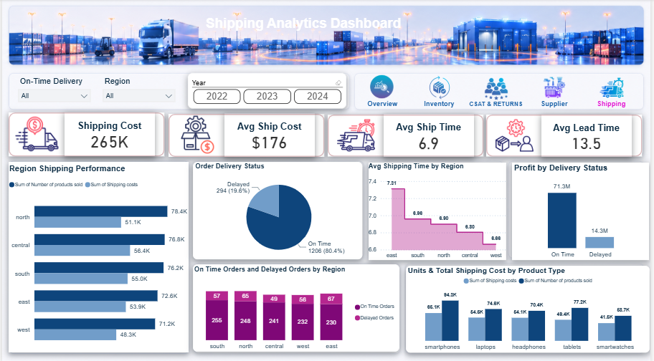

Slide 45
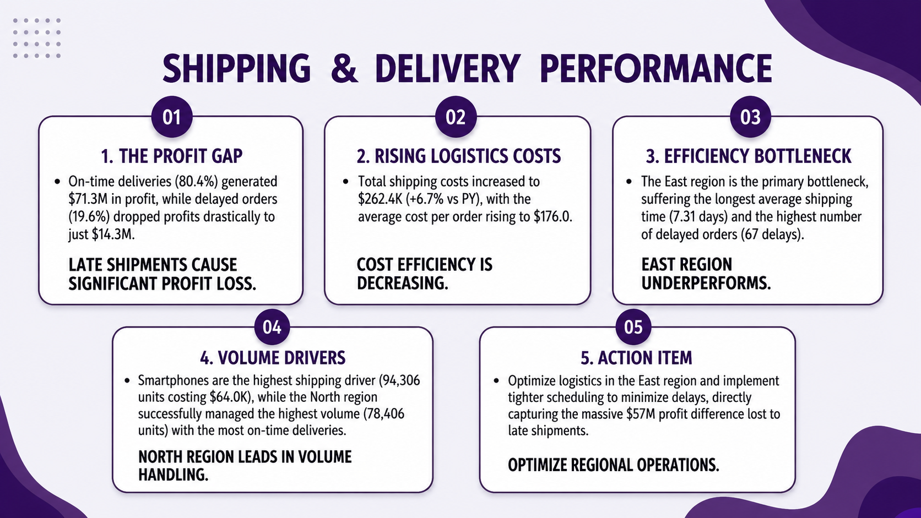
45

Slide 46
recommendations
46

Slide 47
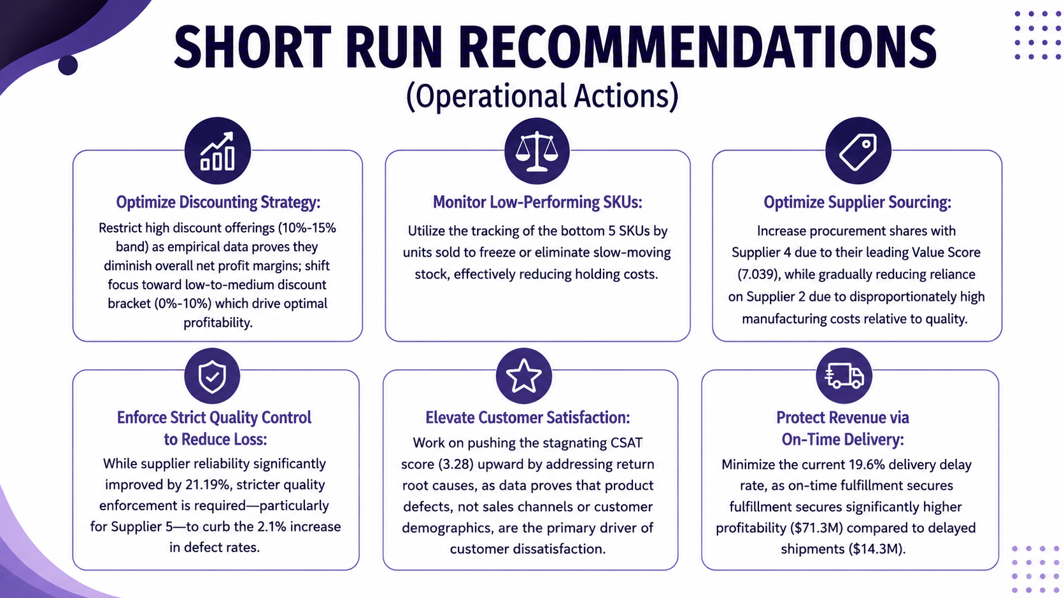
47

Slide 48
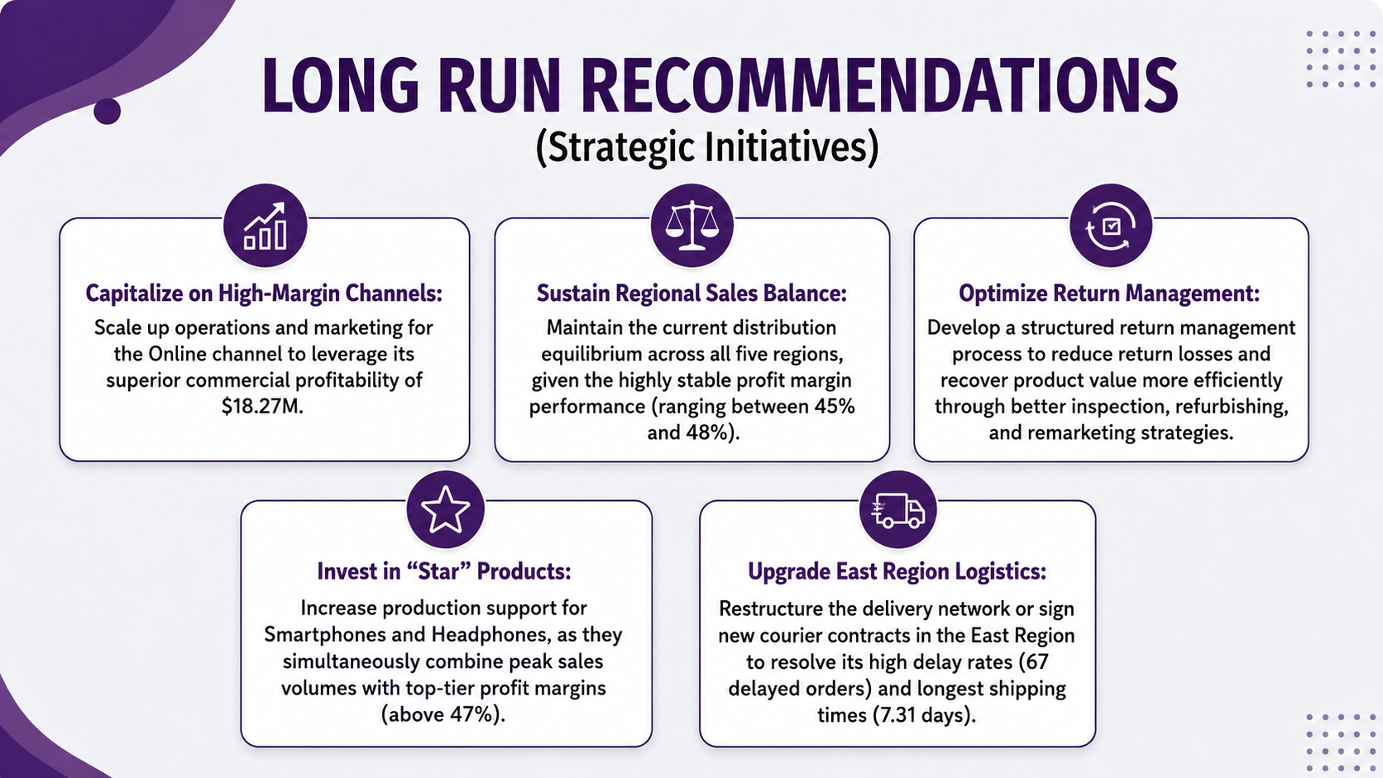
48

Slide 49

49

Slide 50

50

Slide 51

51

Slide 52

52

Slide 53

53

